Slide 1


Upper HOUSE ATTENDANCE - 2017
- YASHWANTH KT

Slide 2
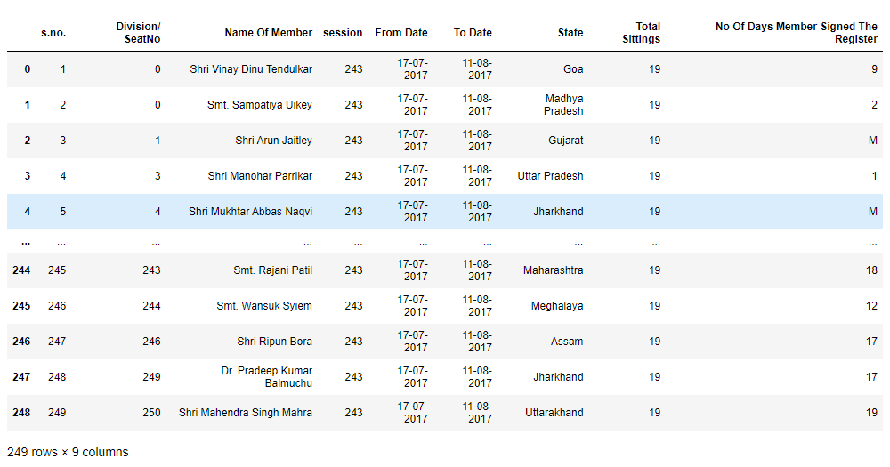
Basic INFORMATION from Data
The data consist of
249 rows and 9 columns
9 columns include 4 integer and 5 objects
There are 243 Sessions and Total Settings of 19
Date starts from July to August month in the year 2017
There are total of 249 Member's name

Slide 3
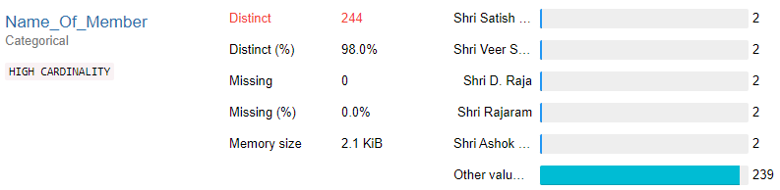
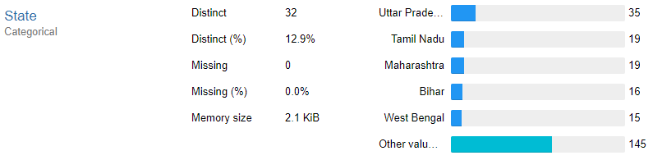
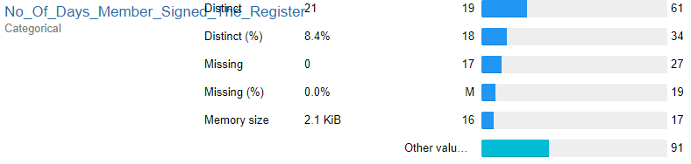
Exploratory Data Analysis
There are 5 member's name repeated
239 other member's name
Top 5 States are
Uttar Pradesh(35) - 14%
Tamil Nadu(19) - 8%
Maharashtra(19) - 8%
Bihar(16) - 6%
West Bengal(15) - 6%
61(24%) of members have signed all days
34(14%) of members have signed 18 days
27(11%) of members have signed 17 days

Slide 4
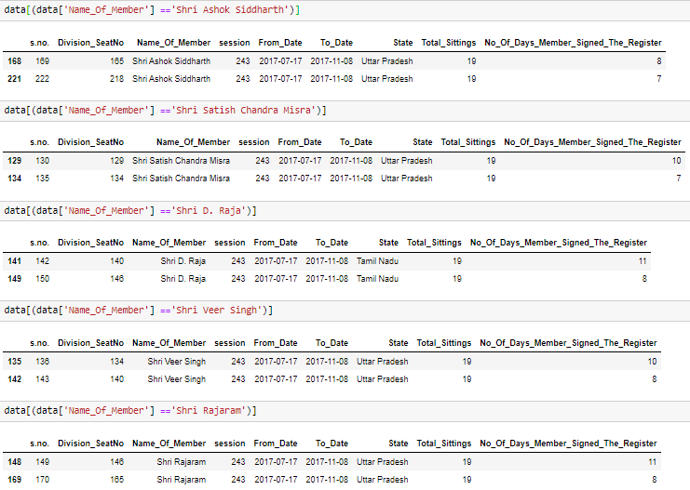
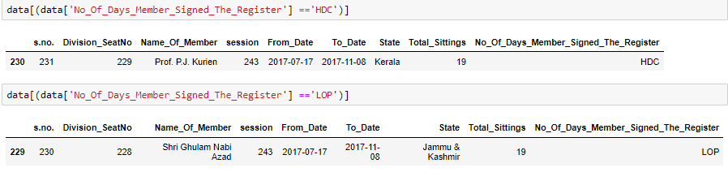
Details about Member's
There are total 244 Member's, which includes 19 Ministers, 1 Leader of Opposition Party(LOP) and 1 Honorable Deputy Chairman(HDC)
Name is repeated
Information of states and name of member's
HDC and LOP

Slide 5
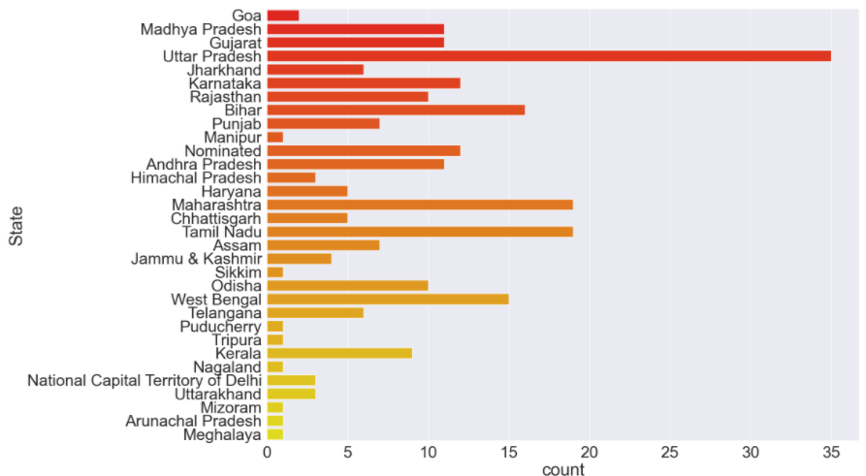
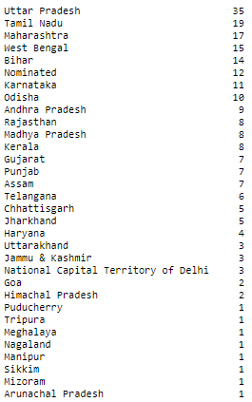
INFORMATION ABOUT StateS
Total States = 32
Top 3 states with more member's
Uttar Pradesh
Tamil Nadu
Maharashtra
States with only one member
Puducherry
Mizoram
Manipur
Meghalaya
Nagaland
Arunachal Pradesh
Tripura
Sikkim

Slide 6
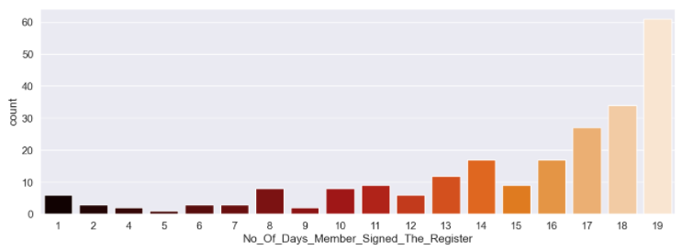

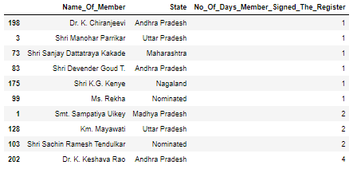

No_Of_Days_Member_Signed_The_Register
Top 3 highest number of days signed
19 days with 61 members signed
18 days with 34 members signed
17 days with 27 members signed
Total of 6 members have signed only 1 day

Slide 7
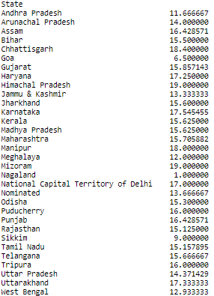
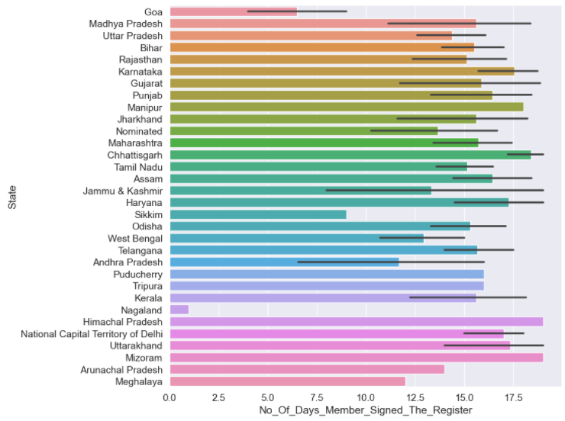
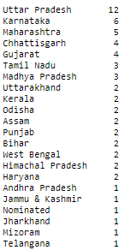
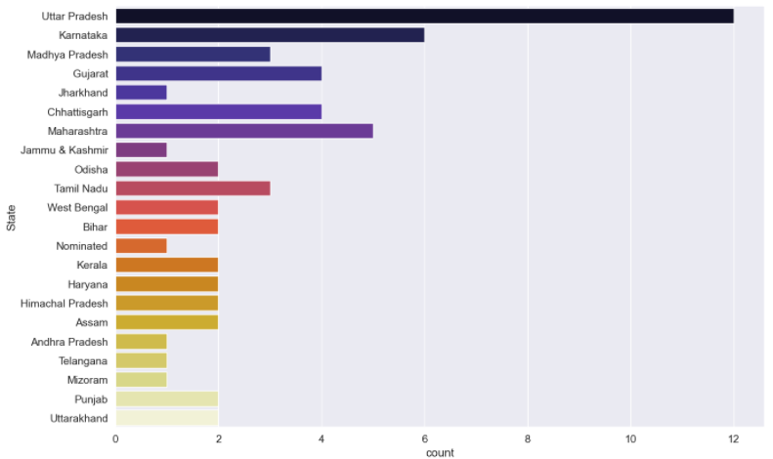
Average Sign Per States
States With 19days Of Sign

Slide 8
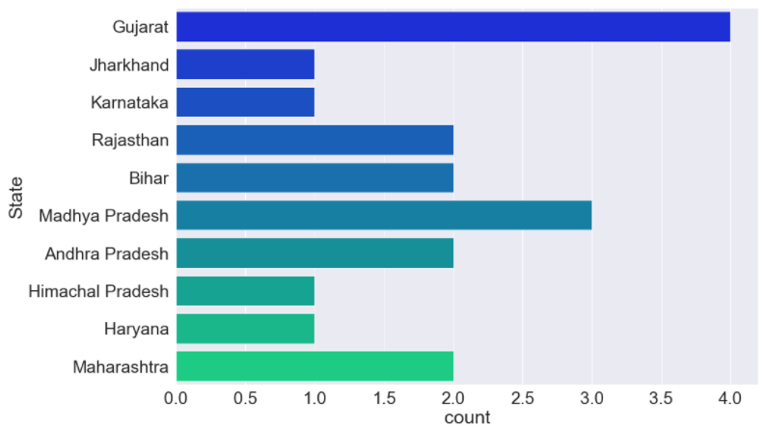
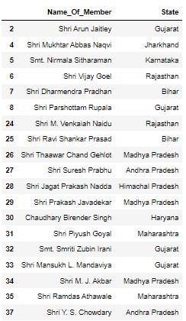
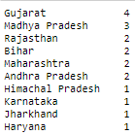
Information about Ministers
Ministers from the States of Himachal Pradesh Karnataka, Jharkhand and Haryana are only one.

Slide 9
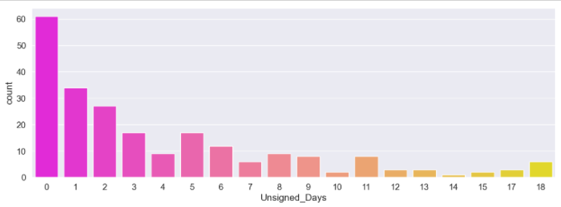

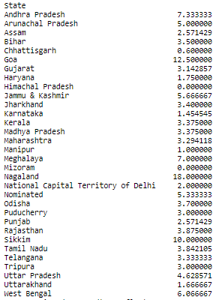

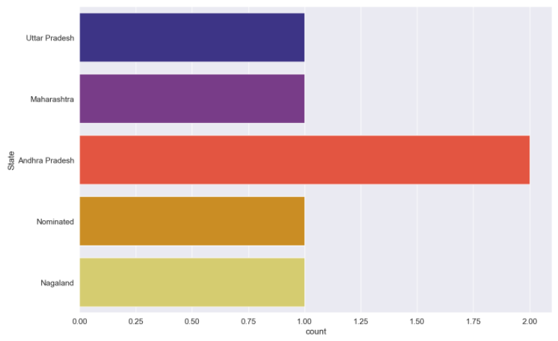
Unsigned days
Uttar Pradesh, Maharashtra, Andhra Pradesh and Nagaland has members who have not signed for 18days

Slide 10
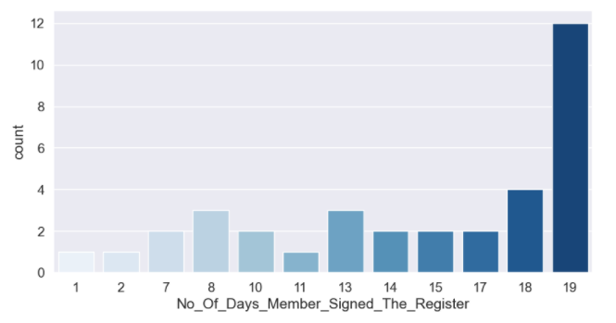

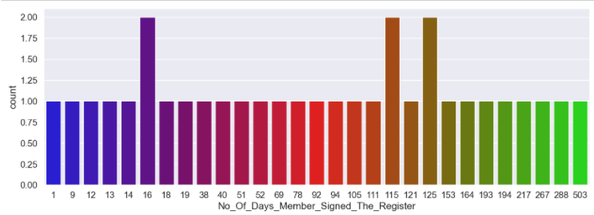
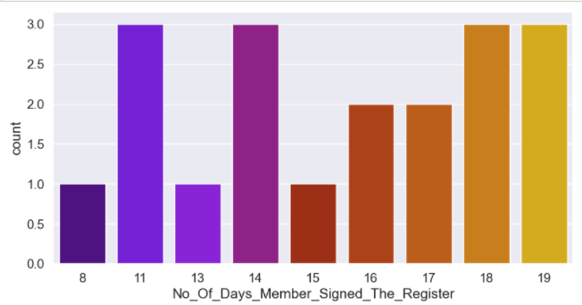
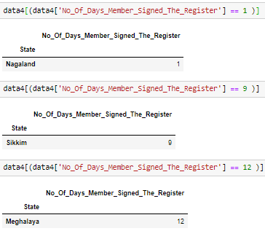
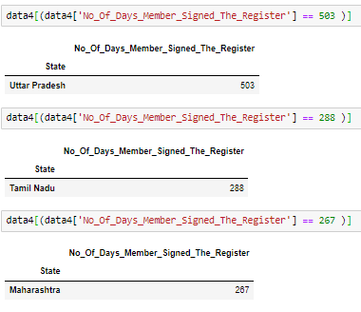
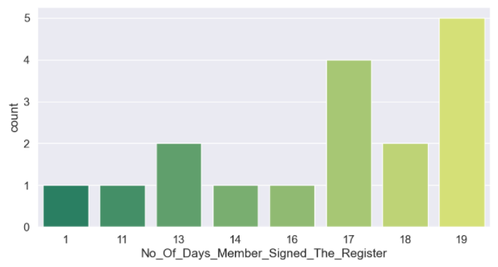
Highest AND LOWEST ATTENDANCE STATES
UTTAR PRADESH
TAMIL NADU
MAHARASHTRA
CONCLUSION
TOP 3 STATES WITH HIGHEST ATTENDANCE ARE UTTAR PRADESH(503), TAMIL NADU(288) AND MAHARASHTRA(267)
BOTTOM 3 STATES WITH LOWEST ATTENDANCE ARE NAGALAND(1), SIKKIM(9) AND MEGHALAYA(12)

Slide 11
THANK YOU
- YASHWANTH KT

